Slide 1
DTPM SIG
02/08/2023
Notes:
Meeting minutes are in the speaker notes for the relevant slide

Slide 2
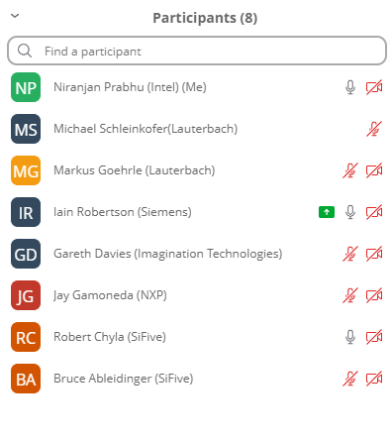
Agenda
Disclosures
Charter – ready for approval?
eTrace packet encapsulation
General transport encapsulation
AOB
Notes:
Attendees: see screenshot on the agenda slide

Slide 3
Disclosures
Video link

Slide 4
Only RISC-V Members May Attend
Non-members are asked to please leave except for Joint Working Groups (JWG).
Members share IP protection by virtue of their common membership agreement. Non-members being present jeopardizes that protection. Joint working groups (JWG) agree that any IP discussed or worked on is fully open source and unencumbered as per the policy.
It is easy to become a member. Check out riscv.org/membership
If you need work done between non-members or or other orgs and RISC-V, please use a joint working group (JWG).
used to allow non-members in SIGs but the SIGs purpose has changed.
Please put your name and company (in parens after your name) as your zoom name. If you are an individual member just use the word “individual” instead of company name.
Non-member guests may present to the group but should only stay for the presentation. Guests should leave for any follow on discussions.

Slide 5
Antitrust Policy Notice
RISC-V International meetings involve participation by industry competitors, and it is the intention of RISC-V International to conduct all its activities in accordance with applicable antitrust and competition laws. It is therefore extremely important that attendees adhere to meeting agendas, and be aware of, and not participate in, any activities that are prohibited under applicable US state, federal or foreign antitrust and competition laws.
Examples of types of actions that are prohibited at RISC-V International meetings and in connection with RISC-V International activities are described in the RISC-V International Regulations Article 7 available here: https://riscv.org/regulations/
If you have questions about these matters, please contact your company counsel.

Slide 6
Collaborative & Welcoming Community
RISC-V is an open ISA enabling a new era of processor innovation through open standard collaboration. Born in academia and research, RISC-V ISA delivers a new level of extensible software and hardware freedom on architecture, paving the way for the next 50 years of computing design and innovation.
We are a transparent, collaborative community where all are welcomed, and all members are encouraged to participate. We are a continuous improvement organization. If you see something that can be improved, please tell us. help@riscv.org
We as members, contributors, and leaders pledge to make participation in our community a harassment-free experience for everyone.
https://riscv.org/community/community-code-of-conduct/

Slide 7
Conventions
For one hour meetings, please start at 5 after the start time in order to allow people going to other meetings have time for a short break between meetings. 30 minute meetings start on time.
Unless it is a scheduled agenda topic, we don’t solve problems or detailed topics in most meetings unless specified in the agenda because we don’t often have enough time to do so and it is more efficient to do so offline and/or in email. We identify items and send folks off to do the work and come back with solutions or proposals.
If some policy, org, extension, etc. can be doing things in a better way, help us make it better. Do not change or not abide by the item unilaterally. Instead let's work together to make it better.
Please conduct meetings that accommodates the virtual and broad geographical nature of our teams. This includes meeting times, repeating questions before you answer, at appropriate times polling attendees, guide people to interact in a way that has attendees taking turns speaking, …
Where appropriate and possible, meeting minutes will be added as speaker notes within the slides for the Agenda

Slide 8
Charter – ready for approval?
Full verbiage is here. Key points:
The goal for the DTPM SIG shall be to define a strategy to establish specifications and guidelines for the interfaces, transports, and other pieces of the SoC infrastructure
The DTPM SIG shall focus on the following areas:
Standard programming interface to aid interoperability
Protocols and formats for debug/trace/performance-monitoring encapsulation
Unified security architecture for debug/trace
Cables and connectors
Debug, Trace, and SoC performance monitoring features
The DTPM SIG shall work on a gap analysis by starting with a lay of the land review on RVI debug, trace, SoC performance-monitoring capabilities
Notes:
Charter will be taken for approval to SoC HC 15-Feb-2023

Slide 9
eTrace Packet Encapsulation
eTrace defines packet payload only. Cannot be transported or decoded without additional information
Source ID
Payload length or some other indication of field/packet boundaries
Options:
Form Task Group
Request fast track under SoC HC
Discussion…
Notes:
Robert: Mechanism for optional timestamp should also be included
Markus: Mechanism to differentiate instruction and data trace.
Could use different source IDs but no-one was in favour of this.
Will discuss logistics of full TG vs fast track with SoC HC chairs Ved & Gadge. All agree we should move this forward at next SoC HC meeting

Slide 10
General transport encapsulation
Requirements for encapsulation (outlined by Markus):
Transport arbitrary byte streams from multiple sources
Must be able to sync onto an on-going byte stream from each source
Must be able to correlate each source with a specific stream even if stream contents are undefined
Encapsulation must not contain any stream or source-specific data, other than the source ID
Existing options:
MIPI WTP/Arm TPIU
Proprietary (e.g. Siemens/UltraSoC)
Discussion…
Notes:
Niranjan: MIPI STP-E is also a possible option
Iain: Not intended as an exhaustive list, but are there any gaps this group thinks we need to pursue?
For example, limited ID space offered by WTP may be a problem with current or future SoCs which have potentially 1000s of trace sources
Iain/Robert: maybe there is a longer term view we need to consider here
General transport encapsulation will be a future topic and the group will focus on eTrace encapsulation as an immediate goal

Slide 11
Future Meetings / AOB
2nd Wednesday of each month
AOB

Slide 12
Thank You

